Slide 1
How Not to Write a User Guide
A short introduction

Slide 2
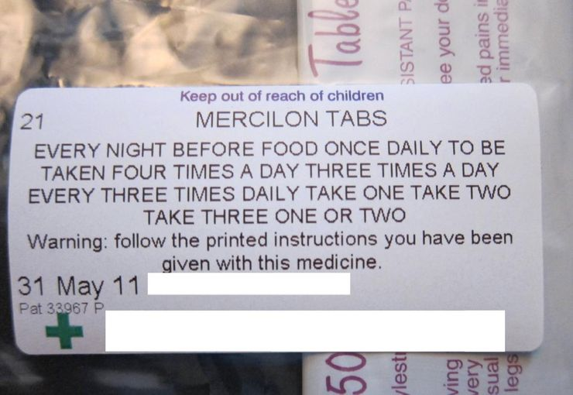
Take this medicine one, two, three or four times

Slide 3
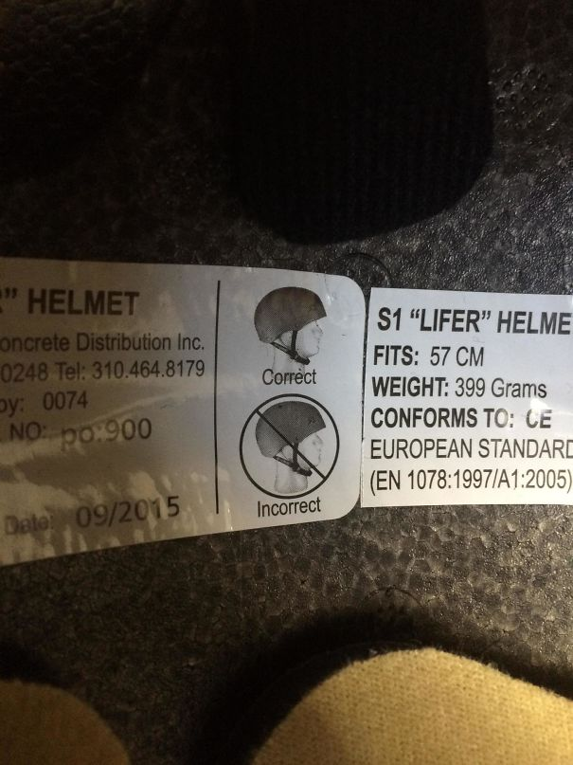
You’re doing it wrong. You’re still doing it wrong

Slide 4
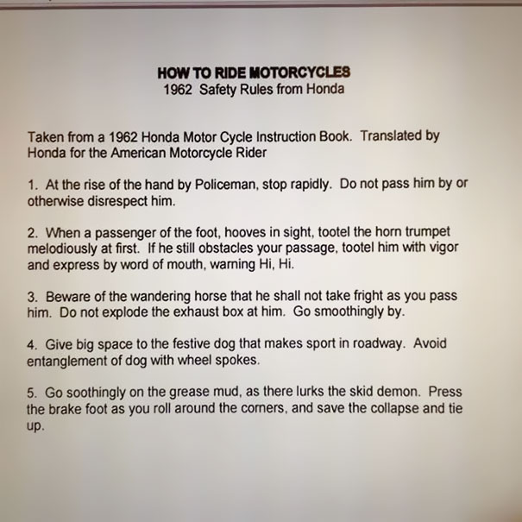
Riding a Honda motorcycle

Slide 5
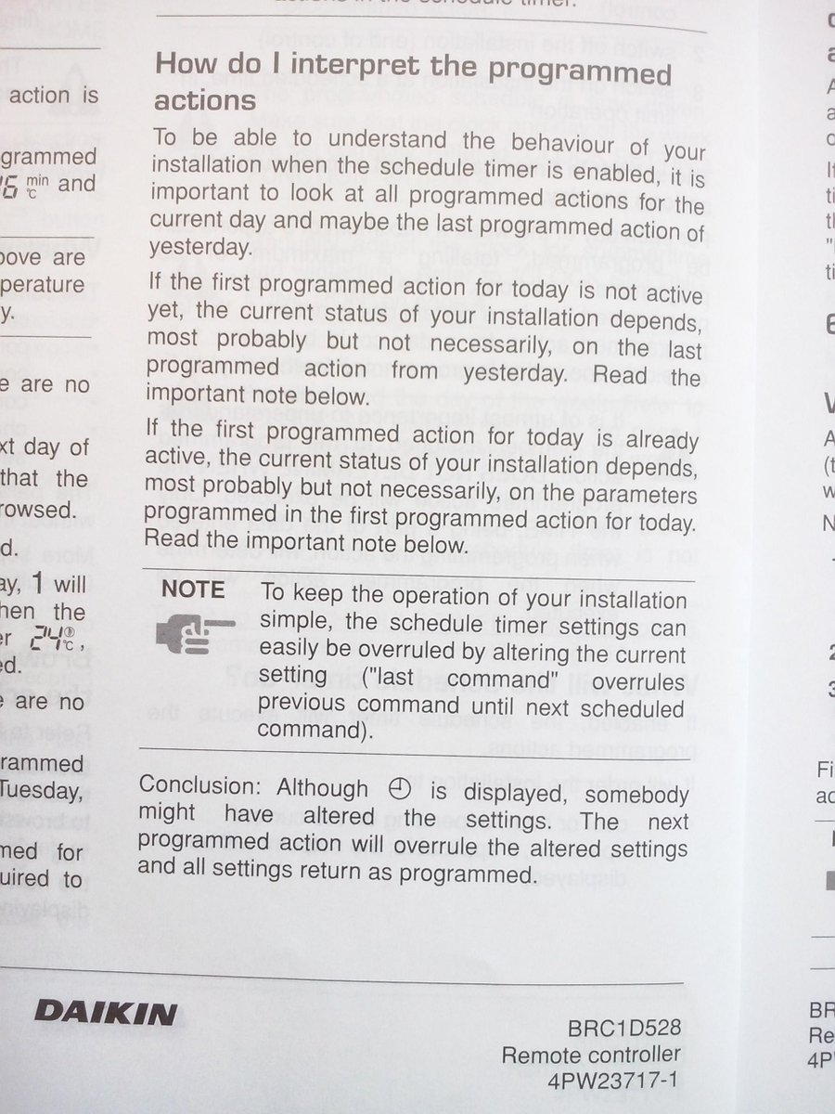
How do I interpret the programmed actions?

Slide 6


Slide 7
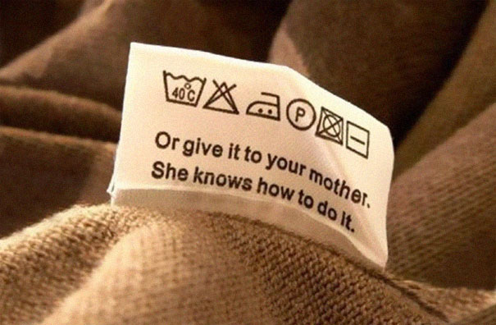

Slide 8
DEFINITION
A user guide or user's guide, also commonly known as a manual, is a technical communication document intended to give assistance to people using a particular system.
Manuals are written guides or reference materials which are used for training, assembling mechanisms, operating machinery or equipment, servicing products, or repairing products.

Slide 9
Components of a User Guide
Front and back covers
Title page
Edition notice
Trademarks and Disclaimers
Warranties
License agreements
TABLE OF CONTENTS
Preface, Introduction, Product description
Getting started information
Installation procedure
Operating, maintenance, and trouble shooting instructions with safety notices
APPENDIXES
Glossary
Index
Reader-comment form

Slide 10
Instructions and User Guides
Consumer-Oriented instructions
Instructions written to facilitate clients, customers, employees etc who have non- engineering background
User guide –Product or a service
A comprehensive guide that includes instructions (along with other elements) for mainly users with technical background

Slide 11
Approaches to Writing Instructions
Feature and function oriented approach
Task oriented approach

Slide 12
Feature and function oriented approach
Focuses on explaining/describing each button, switch, knob, menu, and option, as they function individually.
Works if
The product is simple
Combination of feature are not needed to accomplish tasks
The labels are adequately self descriptive

Slide 13
Task-oriented approach
Focus is on accomplishing a task as a result of a combination of functions or parts.
Works when
The task is relatively more complex
Should involve a “How to……” situation
A variety of steps is involved to accomplish a task

Slide 14
Points to remember
Analyze the audience
Analyze the purpose
Analyze the context
Apply SCOPE

